Slide 1

(C.) Wallstreetbets Data from r/wallstreetbets: https://www.kaggle.com/datasets/gpreda/ reddit-wallstreetsbets-posts
Build a tool to extract the relevant financial entity discussed by Reddit users and analyze whether the content relates to the stock market’s Performance and if it is a reliable prediction

Slide 2
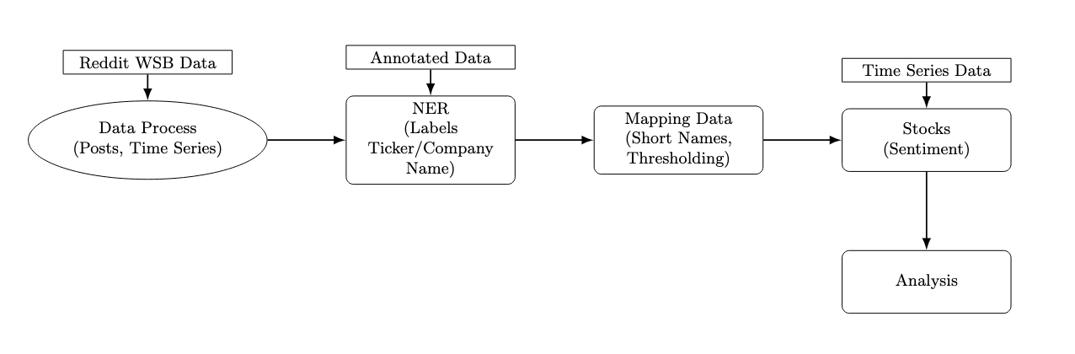

Slide 3
Preprocessing

Slide 4
Processing steps
- Combine title and body
- Remove links
- Remove stopwords
- Decode emojis to useful text

Slide 5
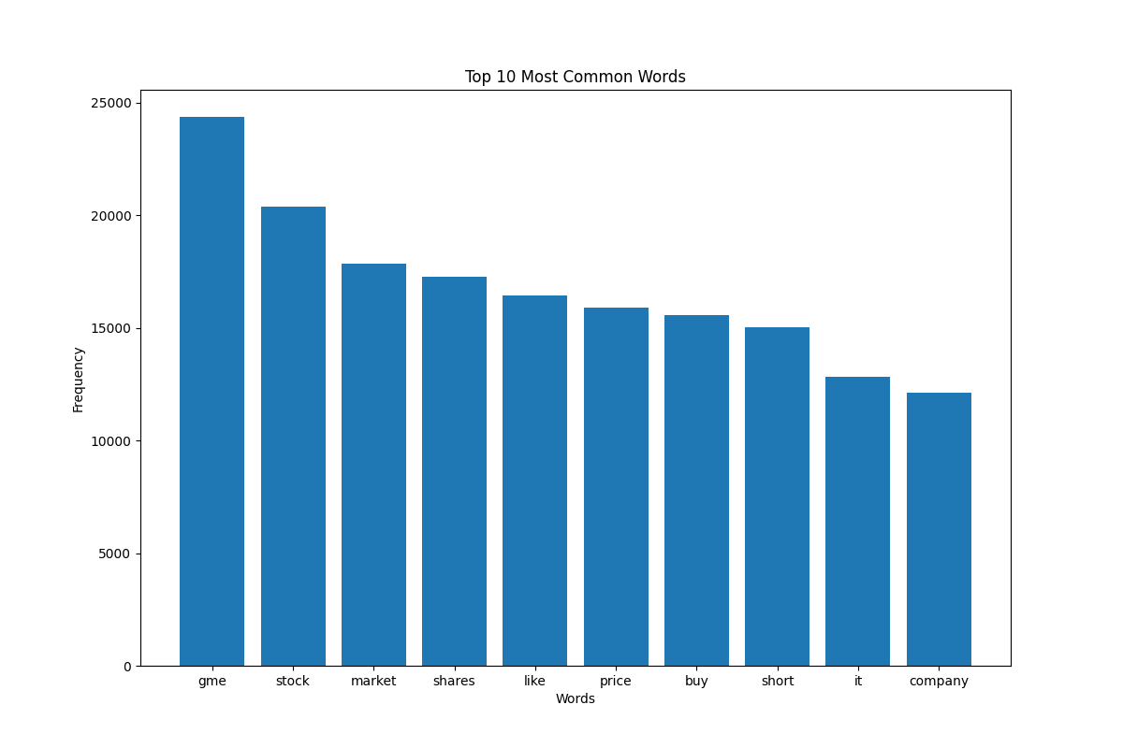

Slide 6
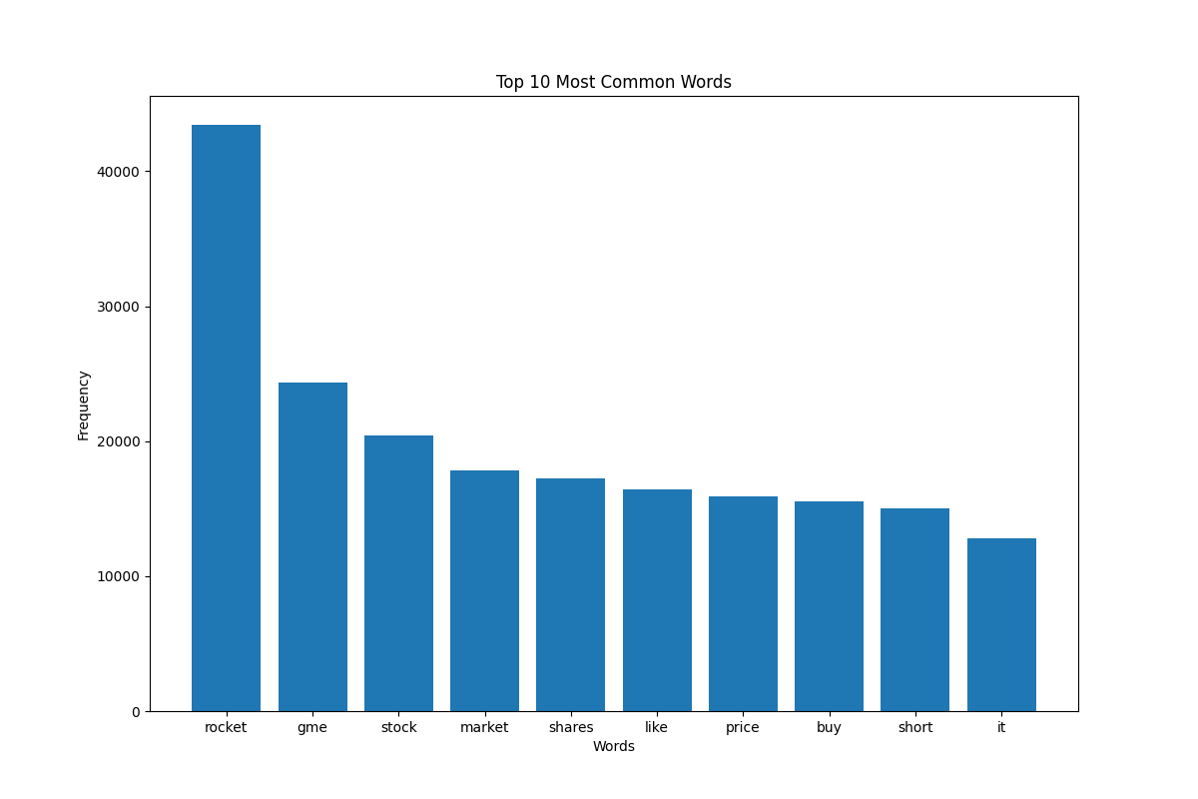

Slide 7
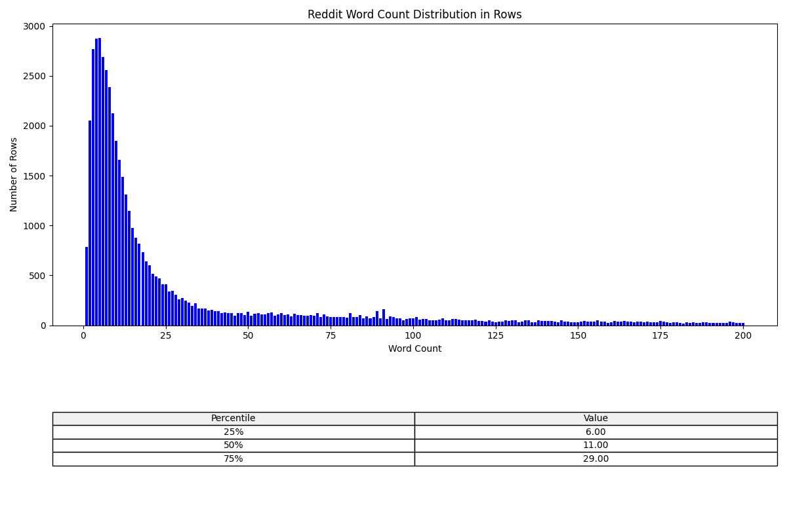

Slide 8
Models used
NER
Find and detect tickers/companies in posts
Record linking
Links entities from posts to US stocks
Text classification
Sentiment analysis of posts
Comparing different pre-trained models

Slide 9
Analyze ideas Ideas in process
Focus on GME
High volume of posts related to GME makes it a natural choice.
Sentiment Mapping
Map Reddit post sentiment to a time series for the mentioned stock.
Simple Evaluation Strategy
Develop a basic buy/sell strategy based on Reddit sentiment trends.

Slide 10
